Slide 1

Chapter 5
How to script forms and controls
Notes:
Session: Ghi số thứ tự session trong môn học
Session Name: ghi tên của session sẽ dạy

Slide 2
Objectives
DOM scripting properties and methods
The FAQ application
How to script forms and controls
The Register application
How to add new nodes to the DOM
The Register application with a table
Notes:
Mô tả nội dung mà học viên phải đạt được khi kết thúc môn học này

Slide 3
DOM scripting
properties and methods
Notes:
Session: Ghi số thứ tự session trong môn học
Session Name: ghi tên của session sẽ dạy

Slide 4
DOM scripting concepts
The DOM(Document Object Model) is a hierarchical collection of nodes in the web browser’s memory that represents the current web page.
The DOM of a web page is built as the page is loaded by web browser.
JavaScript can modify the web page in the browser by modifying the DOM.
To modify DOM you can use properties and methods of it.

Slide 5
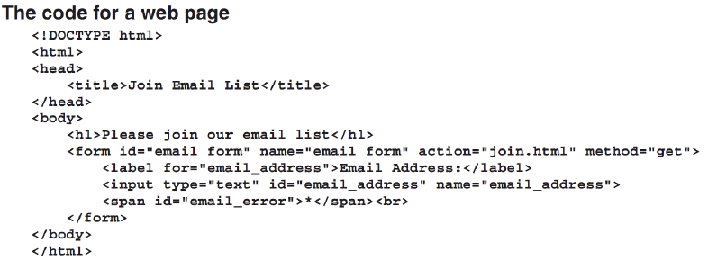
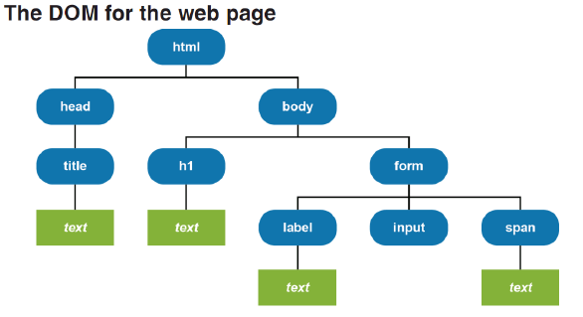
DOM scripting concepts (Cont.)

Slide 6
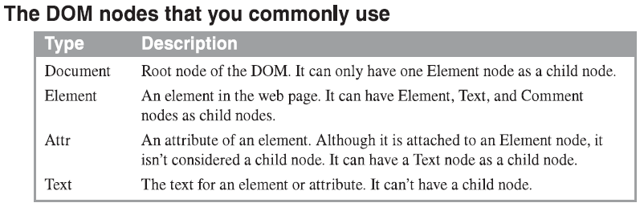
DOM scripting concepts (Cont.)

Slide 7
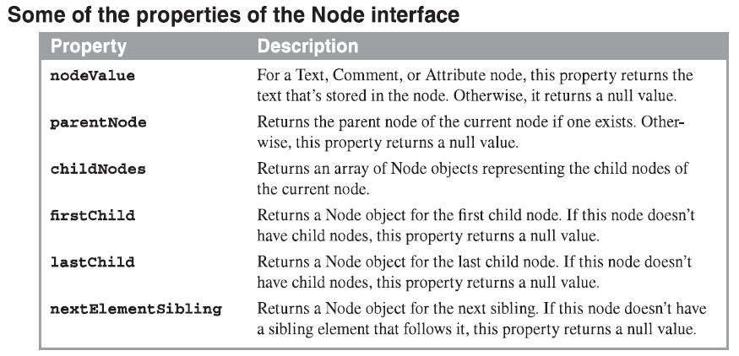
The properties of the Node interface

Slide 8
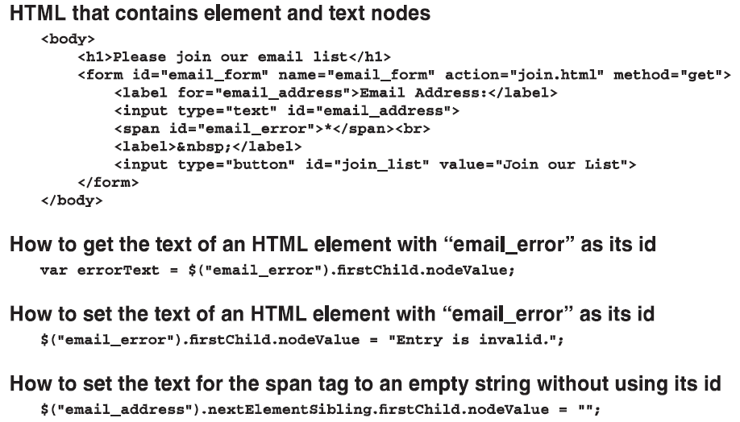
The properties of the Node interface(cont.)

Slide 9
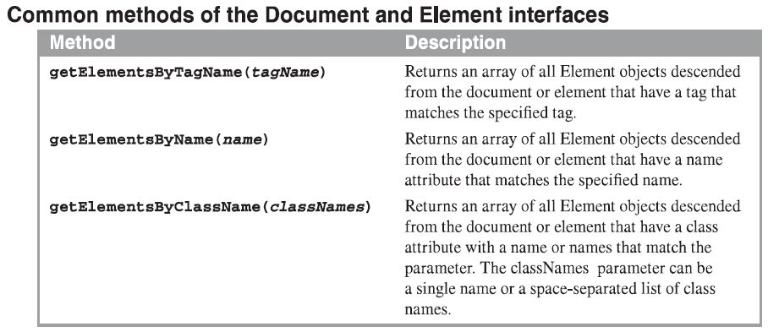
The methods of Document and Element interfaces
The methods of the Document and Element interfaces let you get array of elements

Slide 10
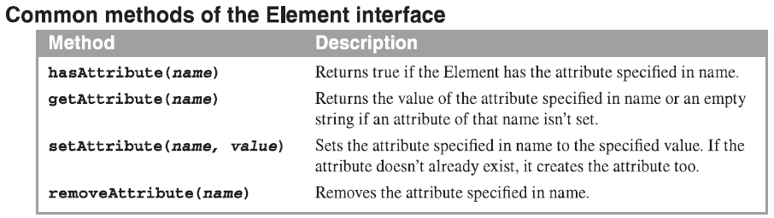
The methods of Document and Element interfaces(cont.)
The methods of the Element interfaces also let you work with attributes

Slide 11
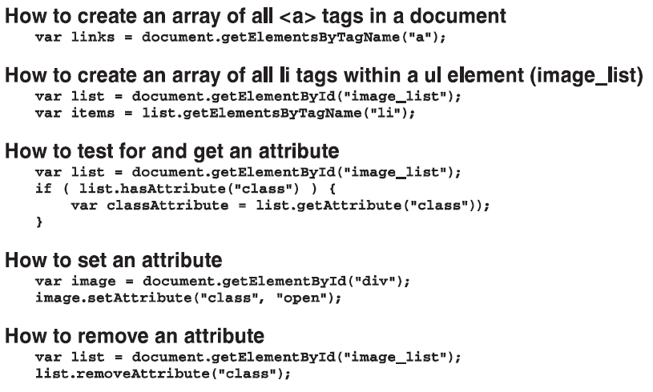
The methods of Document and Element interfaces(cont.)

Slide 12
The properties of the DOM HTML specification
The HTML Specification provides shortcuts that make it easier to work with DOM nodes.
Typical properties available with the DOM HTML specification
Element | Property | Attribute
all | id | The id attribute
 | title | The title attribute
 | className | The class attribute
 | tagName | The name of tag like div, h1, h2 ..
<a> | href | The href attribute
Img | src | The src attribute
 | alt | The alt attribute
input | disable | The disable attribute

Slide 13
How to code use DOM HTML specification
How to get/set img tag src attribute
var imageElement = $(“iamge”);
alert(imageElement.getAttribute(src));
iamgeElement.setAttribute(src,”lures.jpg”)
Or you can code
alert(imageElement. Src);
iamgeElement.src = ”lures.jpg”;
How to get id attribute of the first element in an array
links = document.getElementsByTagName(“a”);
var firstLinkId = links[0].id;

Slide 14
How to code use DOM HTML specification(cont.)
How to get href attribute of an <a> element
var target = $(“first_link”).href;
How to set/get attribute of an element with two class names
$(“div”).className = “Open plus”;
var classNames = $(“div”).className;
How to disable and enable an element
$(“bntPlay”).disable = true;
$(“bntPlay”).disable = false;

Slide 15
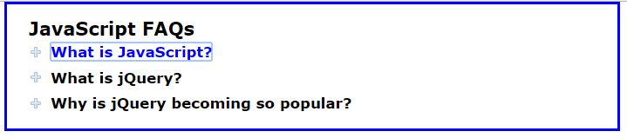
The FAQs application
Notes:
Session: Ghi số thứ tự session trong môn học
Session Name: ghi tên của session sẽ dạy

Slide 16
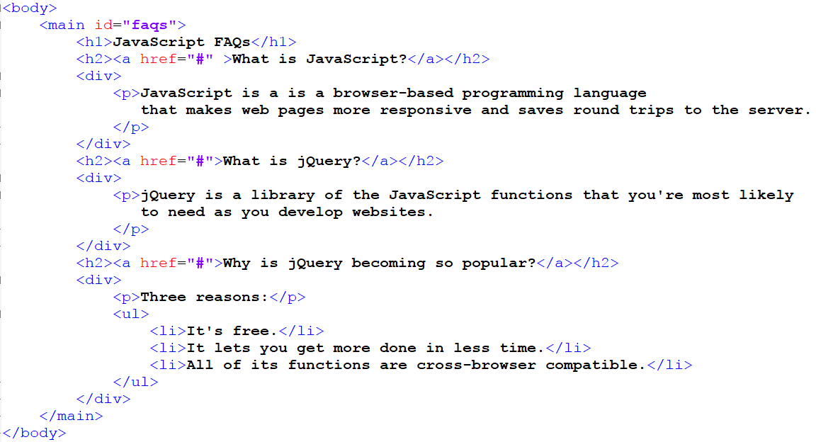
The HTML for FAQs application

Slide 17
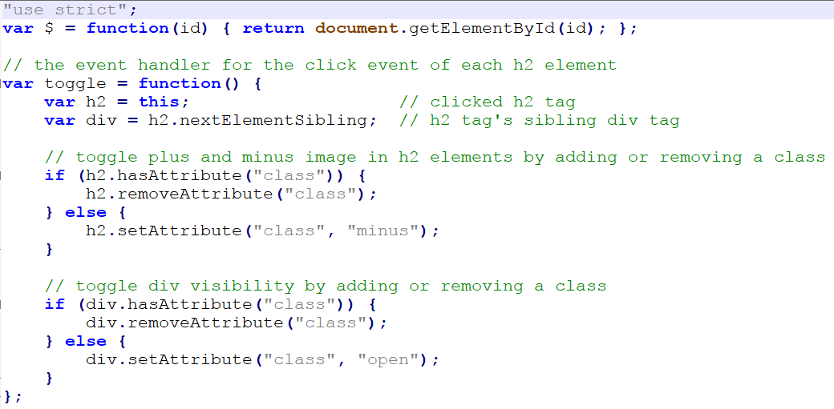
The JavaScript for FAQs application

Slide 18
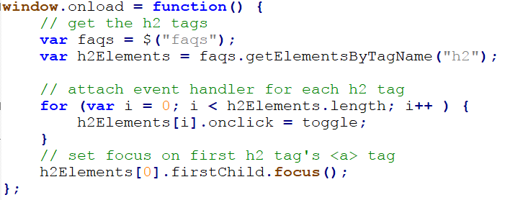
The JavaScript for FAQs application (cont.)

Slide 19
How to script forms and controls
Notes:
Session: Ghi số thứ tự session trong môn học
Session Name: ghi tên của session sẽ dạy

Slide 20
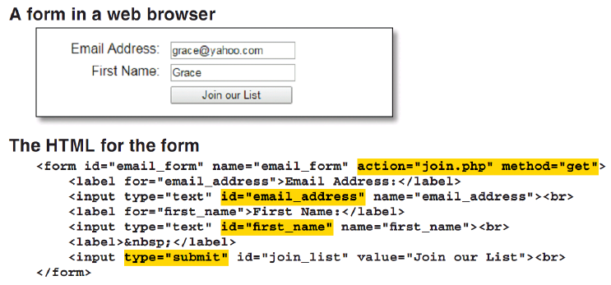
How forms work

Slide 21
How forms work (cont.)
Attributes of the form element
Attribute | Description
name | A name that can be referred by client-side or server-side code
action | The URL of the file that will process the data in the form.
method | The HTTP method for submitting the form data. It is get or set, default is get

Slide 22
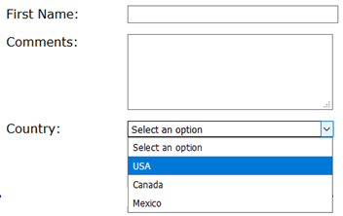
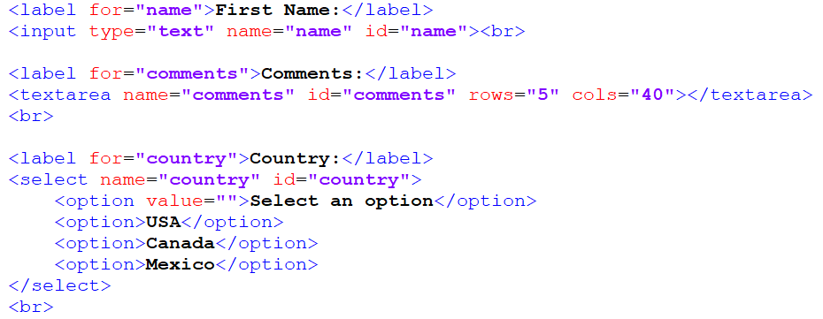
How to script Textbox, Textarea and Select objects
The web interface
HTML code

Slide 23
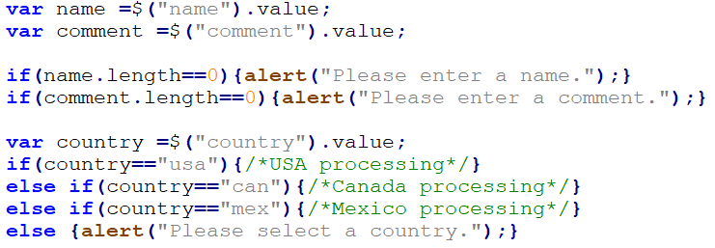
How to script Textbox, Textarea and Select objects (cont.)
JavaScript code

Slide 24
How to script Radio and Checkbox objects
Two properties of a Radio or Checkbox object
Web interface
Property | Description
value | The contents of the value attribute for the button or checkbox. Return a string.
checked | If set to true, the button or checkbox is selected. If set to false, it isn’t selected.

Slide 25
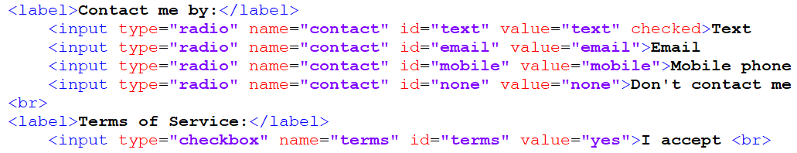
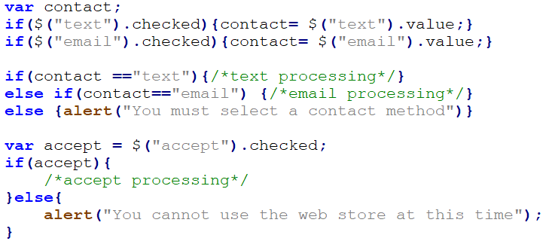
How to script Radio and Checkbox objects (cont.)
HTML code
JavaScript code

Slide 26
How to use the methods and events for forms and controls
Two methods that are commonly used with forms
Two methods that are commonly used with controls
Method | Description
submit() | Submits the form and its data to the server.
reset() | Resets the controls in the form to their starting values
Method | Description
focus() | Moves the focus to the control.
blur() | Removes the focus from the control.

Slide 27
How to use the methods and events for forms and controls(cont.)
Common control events
Event | Description
onfocus | The control receives the focus.
onblur | The control loses the focus.
onclick | The user clicks the control.
ondbclick | The user double-clicks the control
onchange | The value of the control changes
onselect | The user selects text in a text box or text area

Slide 28
How to use the methods and events for forms and controls(cont.)
Statements that use the reset() and submit() methods
$(“registration_form”).reset();
$(“registration_form”).submit();
An event handler for the onchange event of a select list
var investmentChange = function(){
calculateClick();
$(“investment”).blur();
}

Slide 29
How to use the methods and events for forms and controls(cont.)
An event handler for the dbclick event of a text box
var yearDbclick = function(){
$(“years”).value = “”;
};
An onload event handler that assigns event handlers to events
window.onload = function(){
$(“investment”).onchange =investmentChange;
$(“years”).ondbclick = yearsDbclick;
$(“years”).focus();
}

Slide 30
The Registration application Page 184 -187

Slide 31
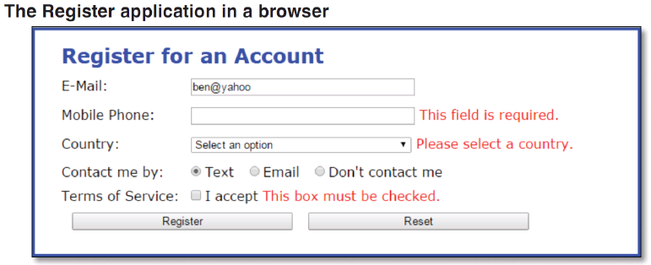
Register application form

Slide 32
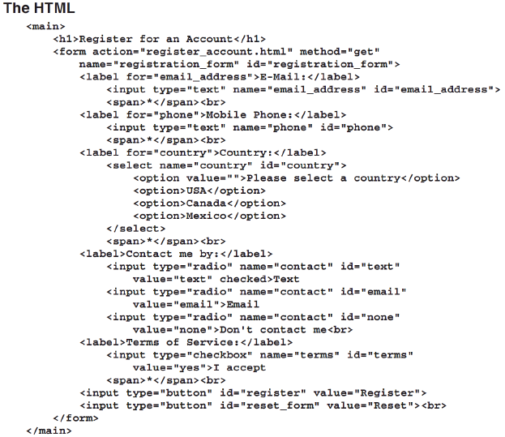

Slide 33
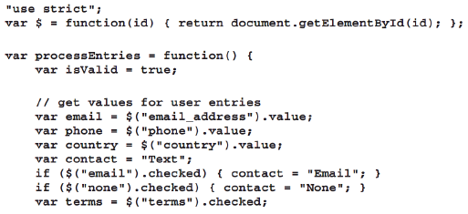
JavaScript

Slide 34
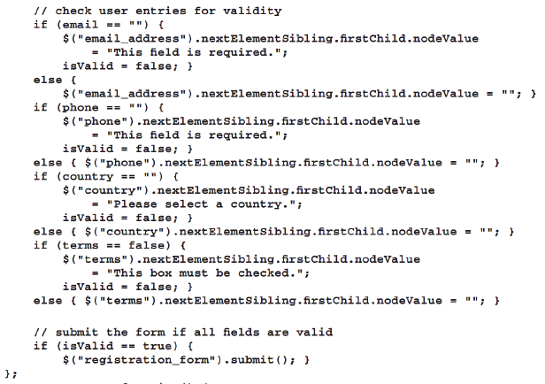

Slide 35
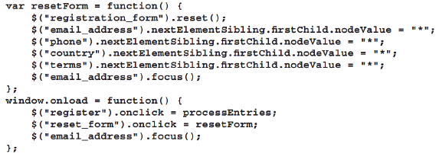

Slide 36
How to add new nodes from the DOM

Slide 37
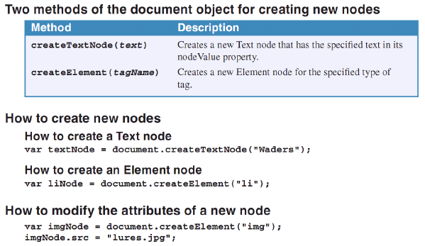
How to create nodes and add them to the DOM

Slide 38
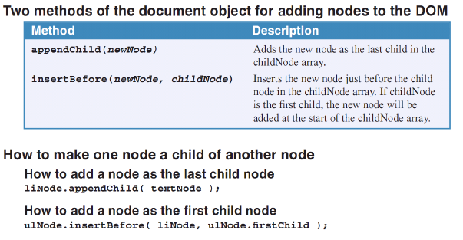
How to create nodes and add them to the DOM (cont.)

Slide 39
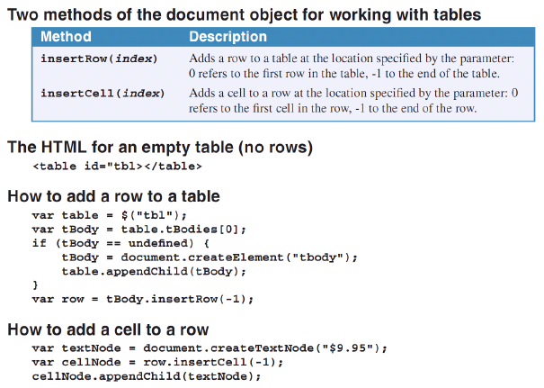
How to create rows and cells to the DOM table

Slide 40
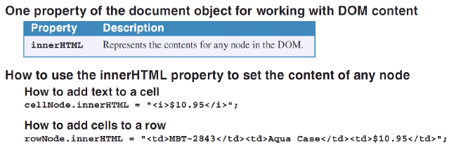
How to create rows and cells to the DOM table (cont.)

Slide 41
The Register application with a table Page (168 – 171)

Slide 42
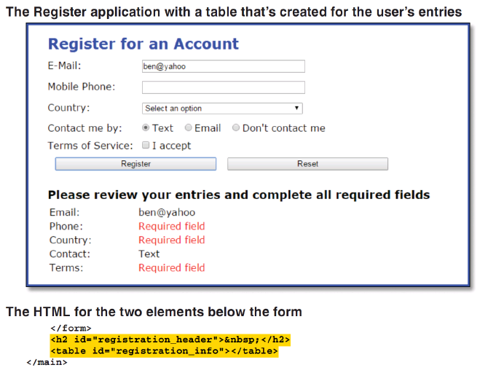
Interface and HTML

Slide 43
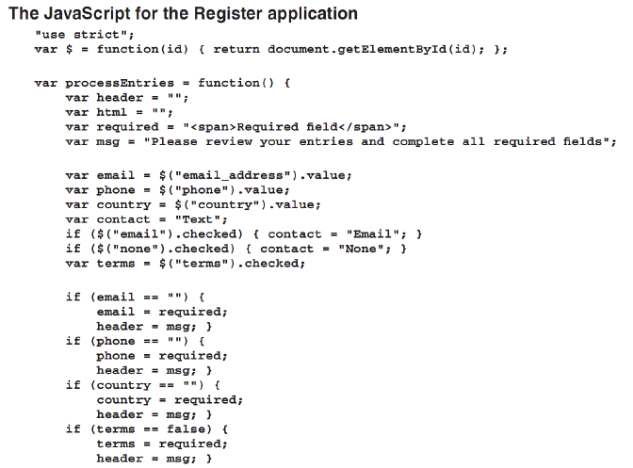
JavaScript code

Slide 44
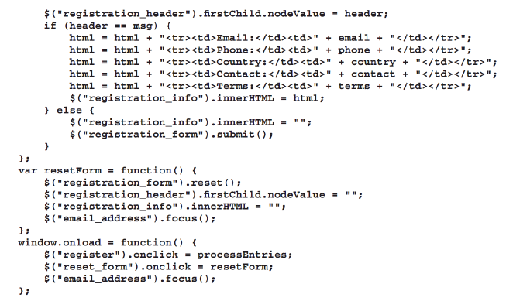
JavaScript code (cont.)

Slide 45
Summary
The DOM(Document Object Model) is a hierarchical collection of nodes in the web browser’s memory that represents the current web page.
The DOM of a web page is built as the page is loaded by web browser.
JavaScript can modify the web page in the browser by modifying the DOM.
To modify DOM you can use properties and methods of it.
Notes:
Tóm tắt lại nội dung đã học

